Slide 1

Unit 7: Sports, Recreation and leisure Activities
Weeks 4 - 6

Slide 2
CloudCampus – Week 4, Lesson 2; Weekly Objectives
Unit 7 Sports & Leisure (Parts A & B)
By the end of this week you will be able to:
Listen & take notes
Write a structured paragraph
Summarise information
Use prepositional idioms
Read & comprehend a variety of texts
Use connectives for paragraph & essay cohesion
Contribute in a group discussion

Slide 3
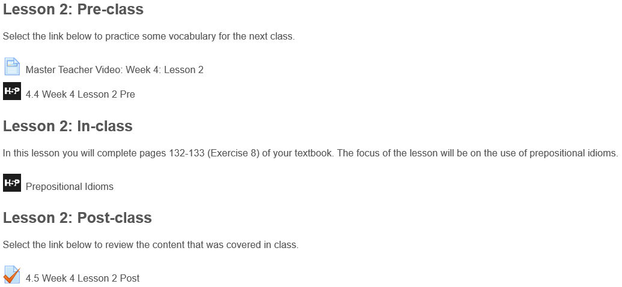
CloudCampus -
Week 4, Lesson 2; Overview

Slide 4
CloudCampus
4.4 Week 4, Lesson 2; Pre-class
Grammar
Introduction: Do you know how to use prepositional idioms?
Purpose: To practice using prepositional idioms
Task: Read the explanation and examples, then answer the questions
Time: 5 – 10 minutes
Next: Revise any of the phrases you are not familiar with

Slide 5
CloudCampus
4.4 Week 4, Lesson 2; Pre-class
Prepositional idioms combine prepositions with verbs, nouns, or phrases to create idiomatic expressions. These expressions can be divided into two categories: idioms that start with prepositions and idioms that end with prepositions.

Slide 6
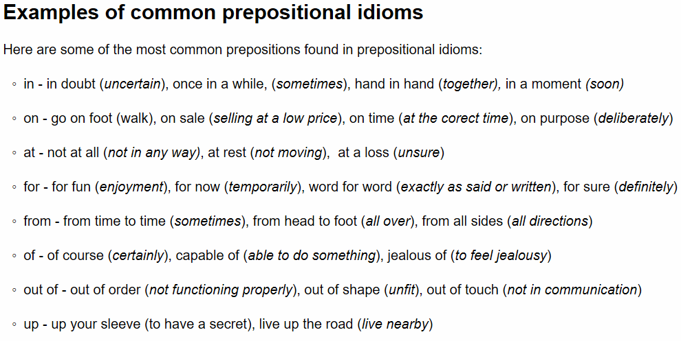
CloudCampus
4.4 Week 4, Lesson 2; Pre-class

Slide 7
More Idioms that Begin
with Prepositions
At
at any rate: whatever happens or is happening
at one's disposal: available for one's use
at fault: causing a problem or accident
at first: in the beginning
at last: finally, after some delay (connotes a feeling of exhaustion after a long period of waiting)
at a loss: unsure of what to do or say; speechless
Behind
behind the scenes: influencing events secretly; unseen
Beside
beside the point: irrelevant

Slide 8
By
by accident: not on purpose
by all means: by any possible method
by hand: without the use of machinery
by heart: from memory
by mistake: accidentally
by oneself: alone
by the way: incidentally (used to introduce a new, unrelated topic)
For
for good: permanently
for a living: as a profession
for one thing: because of one reason (out of several)
for sale: intended to be sold
for sure: definitely
for now/ for the time being: until some other arrangement/decision is made
for a while: for a period of time
From
from scratch: from raw ingredients/materials; without anything pre-made
from time to time: occasionally
Of
of course: certainly; as one would expect; as everyone knows
Off
off and on: (describes a situation that exists at sometimes, but not others, over a period of time)

Slide 9
In
in advance: before something begins
in any case: whatever happens
in charge: in command; responsible for
in common: shared by two or more people
in danger: likely to be harmed
in a daze: unable to think clearly; confused
in debt: owing money
in demand: wanted by many people
in the end: after everything is finished
in fact: in reality; really
in a hurry: doing something quickly
in the long run: in the end; eventually
in a minute/moment/second: soon; quickly
in no time: very soon; very quickly
in season: (fruit or vegetables) ripe and available for sale at that time of year
in trouble: blamed for doing something wrong; in a difficult situation
in the wrong: responsible for an error; guilty

Slide 10
To
to a certain extent: partly
Under
under one's breath: in a whisper; not intending to be heard
under the circumstances: because of the current situation/circumstance
under control: able to be controlled or influenced (opposites: out of control/out of hand)
under fire: being shot at; being criticized
under the impression that: having the idea/belief that
under the influence of: affected by (usually alcohol or drugs)
Up
up in the air: uncertain (with regard to the outcome of a situation)
With
with the naked eye: without the use of a lens
with regard/respect to: concerning; about
with a vengeance: more than usual; angrily
Within
within reason: that is reasonable
Inside
inside out: with the inner side out

Slide 11
On
on account of: because of
on the air: in the process of broadcasting (on radio or television)
on all fours: (people) on hands and knees; (animals) on all four feet
on demand: when requested or demanded
on fire: burning; in flames (not burning as in turning black from staying in the oven too long)
on hand: available; in stock
on the lookout: watchful
on one's own: alone; without assistance
on the other hand: alternatively
on purpose: deliberately
on sale: being sold at a reduced price
on second thought: after thinking further
on the spur of the moment: spontaneously; on a sudden impulse
on time: at the correct time
on the verge of: very close to (an achievement)

Slide 12
Out
out of the blue: unexpectedly
out of breath: panting from a shortage of oxygen
out of character: different from a person's known character
out of order: not functioning
out of the ordinary: unusual
out of practice: unable to do something as well as one once could because of lack of recent practice
out of the question: not to be considered; not an option
out of shape: not in top physical condition because of lack of exercise (opposite: in shape)
out of sight: not able to be seen; hidden (opposite: in sight)
out of town: not in the city/town where one normally resides
out of tune: (of music/musical instruments) not at the correct pitch
out of work: unemployed

Slide 13
CloudCampus
4.4 Week 4, Lesson 2; In-class
Grammar
Introduction: The following activities are from pp. 132 – 133 (exercise 8) in your textbook
Purpose: This task will help you practice prepositional idioms and reading comprehension
Task: Read the text and complete the activities
Time: 10 - 15 minutes
Next: Complete the post-class activity 4.5 Week 4, Lesson 2

Slide 14
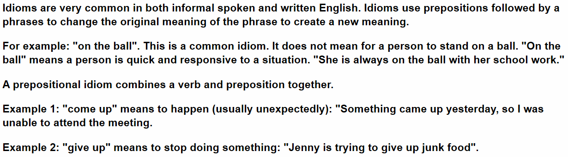
CloudCampus
4.4 Week 4, Lesson 2; In-class

Slide 15
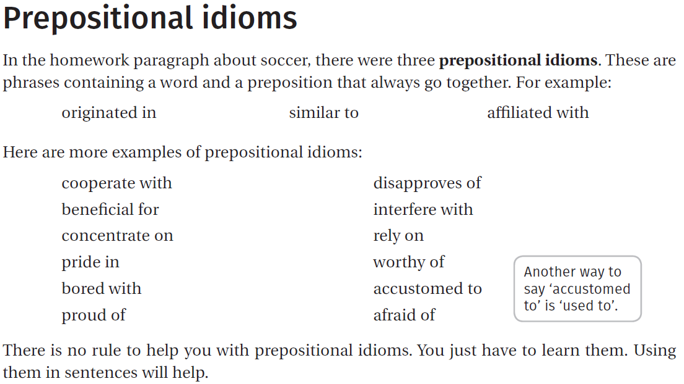
CloudCampus
4.4 Week 4, Lesson 2;

Slide 16
CloudCampus
4.4 Week 4, Lesson 2; Post-class
Grammar
Introduction: What do you remember about prepositional idioms
Purpose: To practice using prepositional idioms
Task: Complete the activity selecting the correct preposition
Time: 5 – 10 minutes
Next: Revise any of the words that you are not familiar with

Slide 17
Weeks 4 - 6 Lesson 3 Pre-Class
Master Teacher Video: Week 3: Lesson
Introduction: The following activity is from p. 126 (Exercise 2) in your textbook.
Purpose: This task will help develop your vocabulary and writing skills
Task: To write a short paragraph (approximately 50-80 words) about the results of the in-class survey.
Time: 15-20 minutes
Drag the words into the correct boxes
1. most - greatest in amount
2. many - a large number
3. several - more than 2 but not many
4. a couple - usually 2
5. a few - a small number
6. some - at least a small number

Slide 18
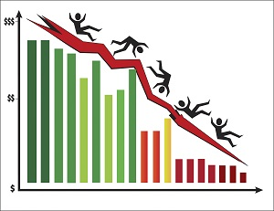
Weeks 4 - 6 Lesson 3 Pre-Class
Student leisure activities:
read 5 5%
listen to music 32 32%
watch tv 1 1%
play video games 10 10%
browse internet 52 52%
The paragraph below summarizes the above survey data.
Drag the words into the correct boxes to complete the summary of the survey data.
Most students in the class browse the internet during their leisure time while many, 32%, prefer to listen to music. Some play video games, a few read and only 1% watch TV.

Slide 19
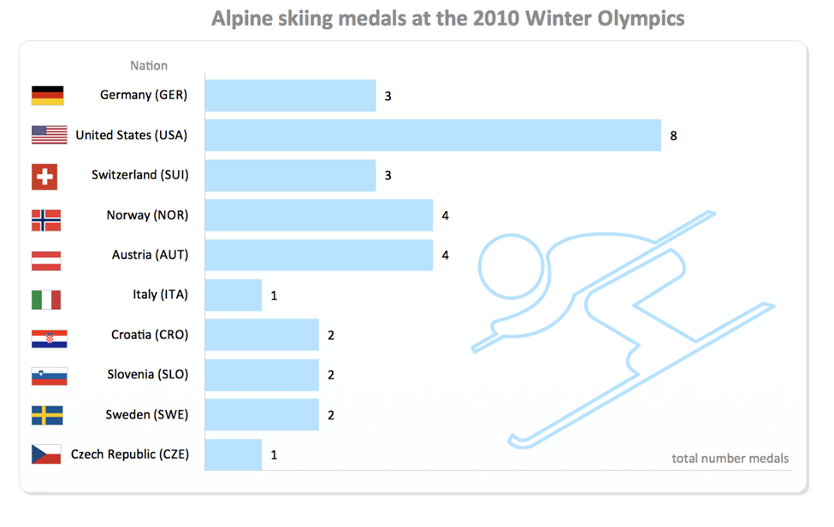

Slide 20
Lesson 3 Weeks 4 - 6 In-class
In this lesson you will complete pages 125-126 (Exercises 1 & 2) of your textbook. The focus of the lesson will be on collecting and summarizing survey data.
1. Read the information on the previous slide about the 2010 winter Olympics, Alpine Skiing medal results. Choose the correct word to complete the summary below: Summarizing results
Many countries competed in the winter Olympics: Alpine skiing. While the United States won the most medals, with a total of 8. Norway and Austria came in equal second, with both countries winning a total of 4 medals. A couple of countries came in equal third, winning a total of 3 medals each. A Few countries won two medals for their countries. Finally, some countries only won 1 medal for their country.

Slide 21
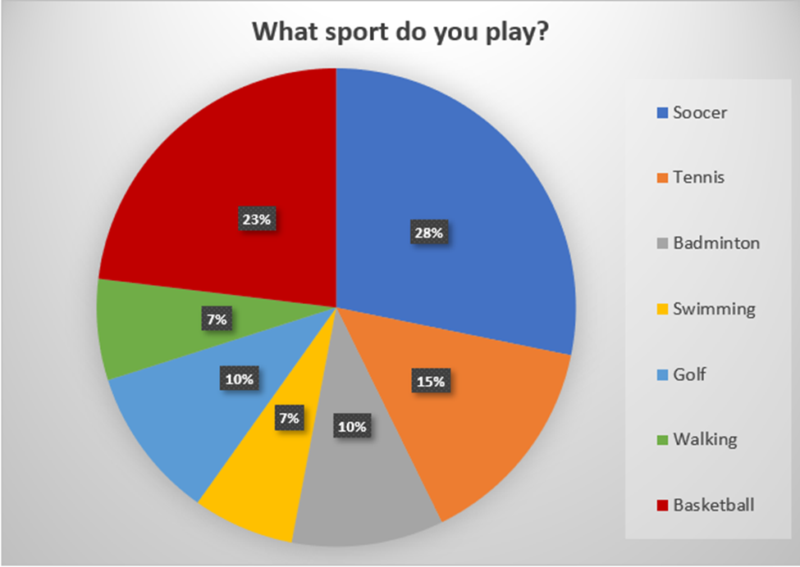
2. Read the information below about what sport people play. Complete the summary below.
The most popular sport is soccer with 28%. Although a lot of people, also like to play basketball with a percentage of 23%. Many people also like to play tennis with a percentage of 15%. Only 10% of people said they liked to play badminton and golf. Also, a few people also said they like to go swimming and walking, with both sports getting a percentage of 7%.

Slide 22
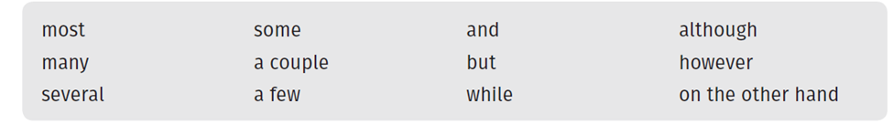
3. Summarize the results of the in-class survey on sport and leisure, that you have done with your teacher.
Writing
Introduction: The following activity is from p. 126 (Exercise 2) in your textbook.
Purpose: This task will help develop your vocabulary and writing skills
Task: To write a short paragraph (approximately 50-80 words) about the results of the in-class survey.
Time: 15-20 minutes

Slide 23
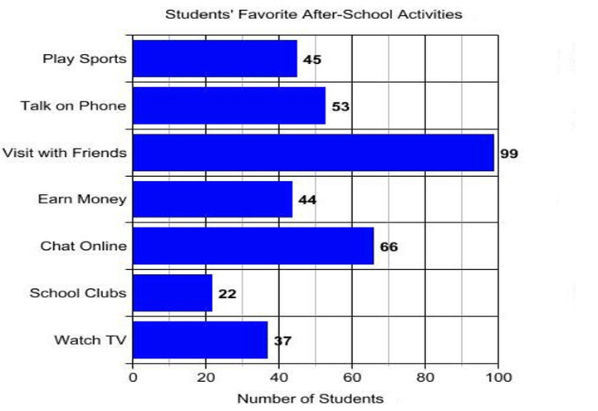
Weeks 4 - 6 Lesson 3 Post-Class
Vocabulary
Introduction: The following vocabulary is from p.126 in your textbook.
Purpose: To review vocabulary for summarizing survey data.
Task: Complete the activity.
Time: 5-10 minutes
Next: Review any incorrect answers.
Task - Read the date in the bar graph about after-school activities of students

Slide 24


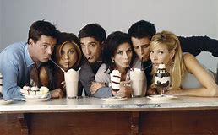

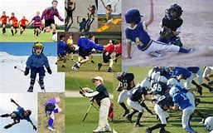


For most students their favorite after school activity is spending time with friends. Many students chat online and talk on the phone, while 37% watch TV, 45% play sports and 44% work after school but only 22% participate in school clubs.

Slide 25
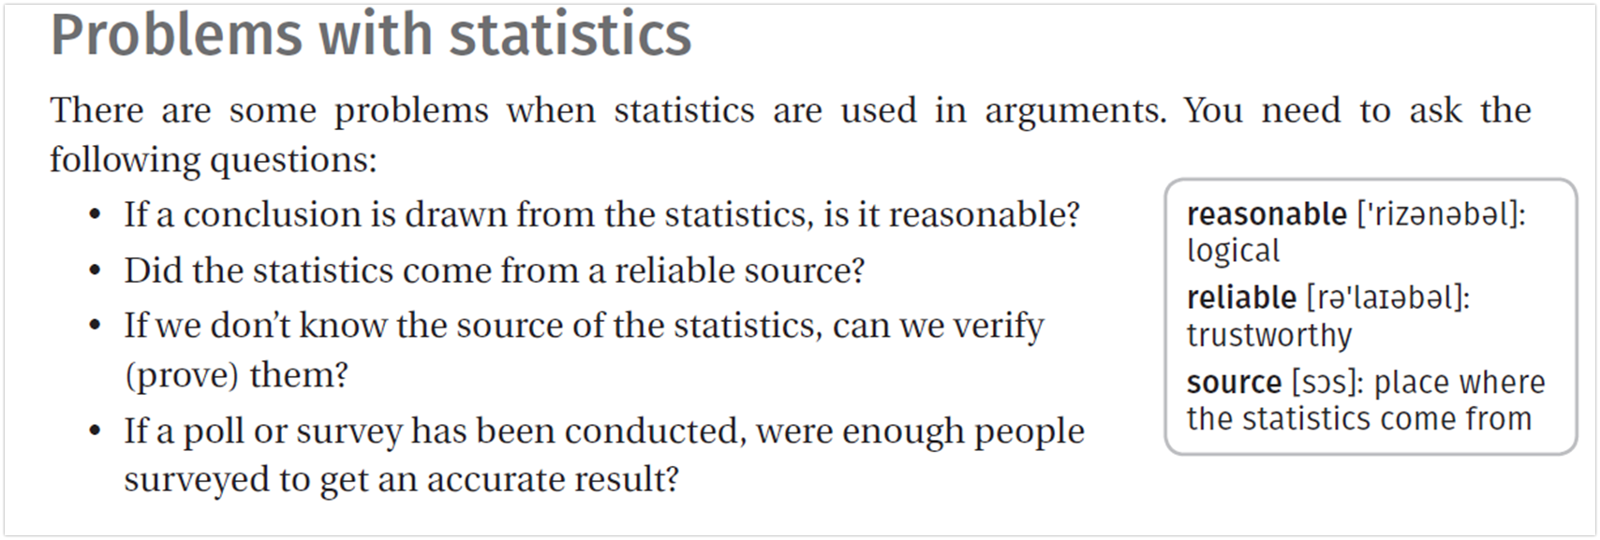
How do I know if I can believe the statistics?
Authority
Does the author or organization that provides the statistics have the qualifications, academic background, or experience to write with authority about the topic?
Bias
Is there a reason to believe that the information provided by the author/organization is designed to persuade the reader? Maybe it only presents part of the whole story?

Slide 26

Weeks 4 – 6 Lesson 5: In-class
Reading Comprehension
Introduction: The following activities are from pp 129 -131 (Homework tasks 1, 2, 3, 4, and 5) in your textbook.
Purpose: This task will help you develop your reading comprehension skills.
Task: Read the text and complete the activities.
Next: Complete the post-class activity 3.11 Week 3, Lesson 5.
Time: 10-15 minutes.

Slide 27
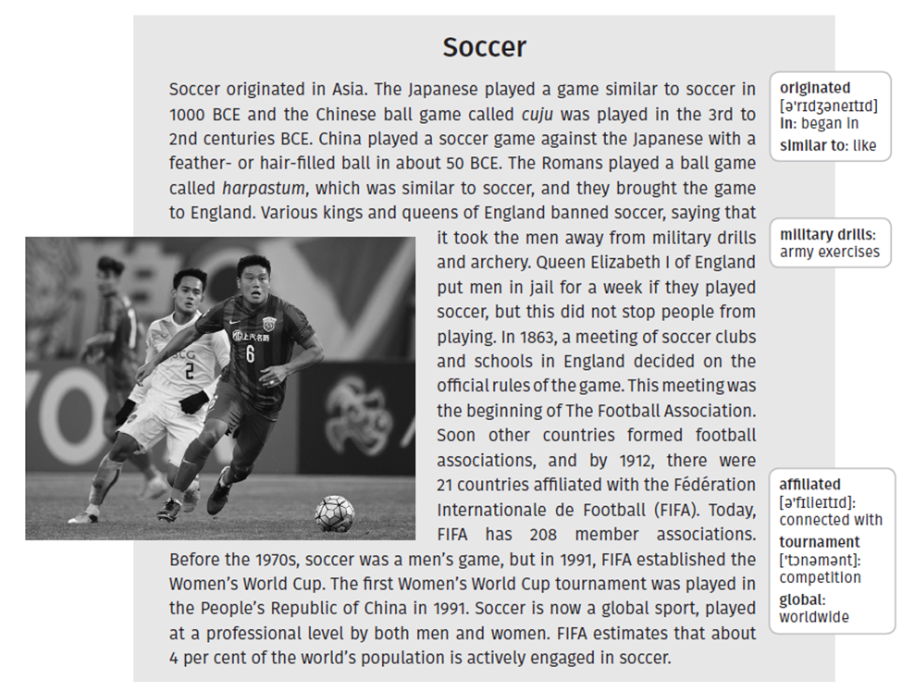

Slide 28
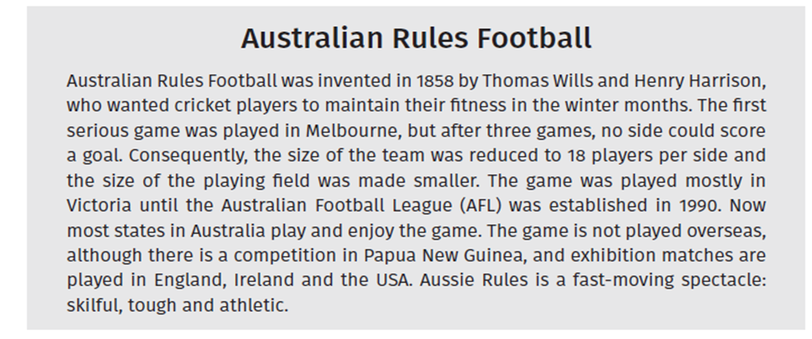

Slide 29

Some Questions for Thought
1. Do you think morning exercise should be compulsory for school students? Support your opinion with at least one reason. Write 1-3 sentences.
You may use the following sentence starter:
Morning exercise should be compulsory because....
or
Morning exercise should not be compulsory because...
2. Do you believe in the saying 'healthy in body, healthy in mind'? Explain your opinion.
You may use the following sentence starter:
I do believe in this saying....
or
I do not believe this because...

Slide 30
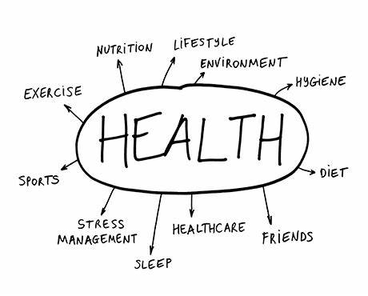
3. Do you like to watch the Olympic Games on television? Why/why not?
4. Do you think it is a good thing for a country to host the Olympic Games? Why/ why not?
5. Do you remember the Beijing Olympic Games of 2008? What is your opinion of that event?
6. Did you watch the Paralympics? Why/ why not?
7. Do you think that sportsmen and sportswomen are good role models for young people? Why/why not?
8. Do you think that Olympic athletes who have been found guilty of doping (drug use) in the past should be banned from all future Olympic Games? Why/ why not?

Slide 31
Weeks 4 - 6 Lesson 5 Post-Class
Writing - This is an opportunity for you to practice writing your opinion. To practice writing an opinion that is expressed and explained clearly. Write a paragraph (80-100 words) giving your opinion on one of the following topics:
Do you think sportsmen and sportswomen are good role models for young people? Why or why not?
Do you think early morning exercise should be compulsory for school students? Why or why not?
Time: 15-20 minutes
Next: Post your paragraph to this discussion.

Slide 32


